Slide 1


Slide 2
Project: ”Challenge vs Disinformation and Euroscepticism” – Europe for Citizens Programme
Leader partner: San Marzano Sul Sarno - Italy
Associated partner: Vulcan Municipality –Romania
MONICA COSMIN
MUNTEANU CAPRIS
Total budget: 10.080 euro – European Union
Implementation: August 2019-April 2020

Slide 3
A Short Description of the Presentation
1. Vulcan Town - geographically located in Europe – short presentation
2. Our town presented by photos
3. The main projects implemented from European funds, in the last 10 years
4. Projects under implementation on European funds, on the Regional Operational Program, during 2018-2023
5. Disinformation and Euroscepticism – subjects of our project – in Europe and in Romania
6. Conclusions

Slide 4
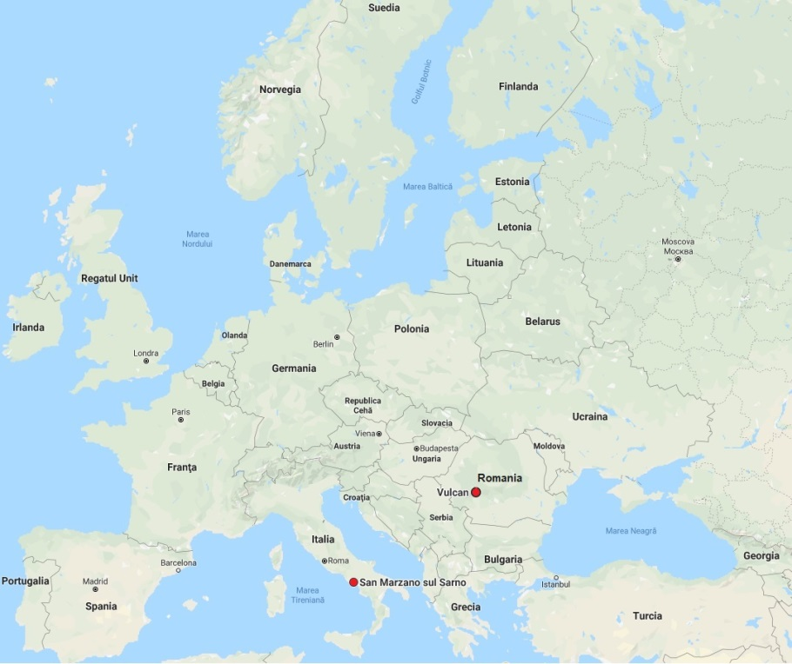
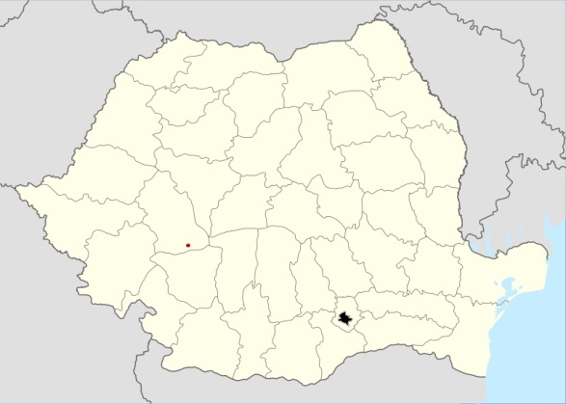
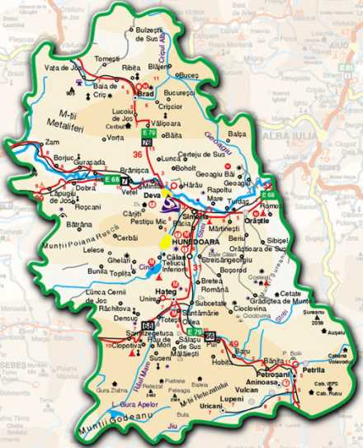
The Map: Europe – Romania- Vulcan Municipality
E u r o p e
R o m a n i a
Hunedoara
County
Vulcan
Bucharest
Capital
Hunedoara
County
Vulcan Town is part of Jiu Valley Mining Region, the largest mining region in the country. In the oficial documents we find it since 1462 and became municipality in 2003. It has around 24,000 inhabitants. The big mining reorganization since 1997 has led to depopulation of the area and we have to find alternative solutions. In the town there is only one coal mine -Vulcan, it has 694 employees (in 1989 it had 3700 employees).

Slide 5
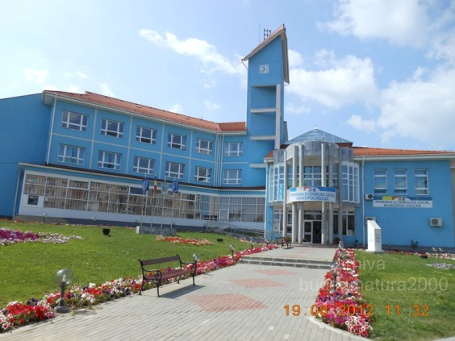
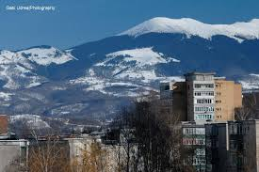
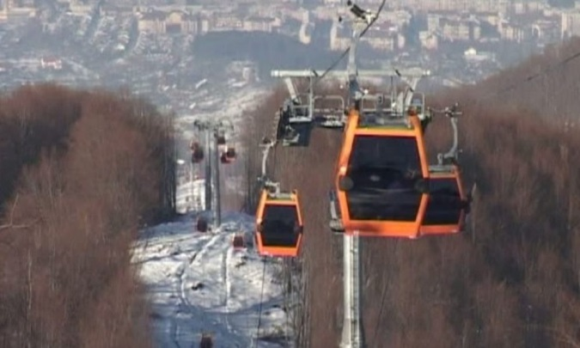
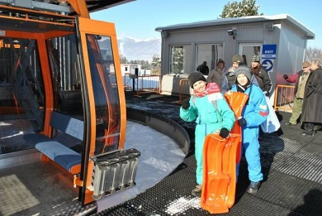
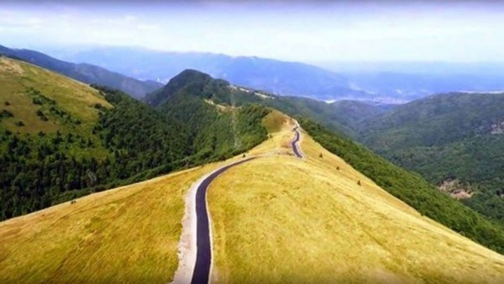
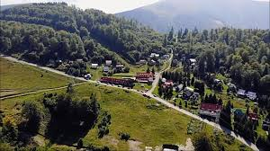
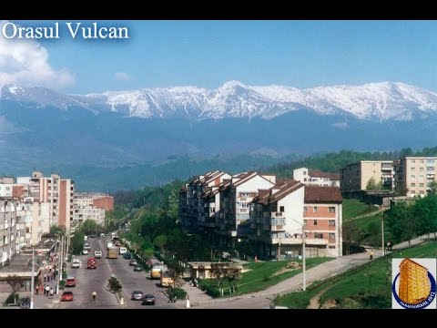
Our town presented by photos
The pictures represent: The Town Hall (the place where we are working ☺; we are surrounded by The Carpathian Mountains; we built a cable gondola from government funds, we are looking for solutions in tourism considering the massive reorganization of the mining industry, Trajan’s Road in Valcan Step )

Slide 6
PROJECTS IMPLEMENTED WITH EUROPEAN FUNDS IN VULCAN MUNICIPALITY IN THE LAST 10 YEARS
THE MODERNIZATION OF WASTE COLLECTION SYSTEM – 1 million euro implemented in 2009 – The images speak more than words ☺

Slide 7
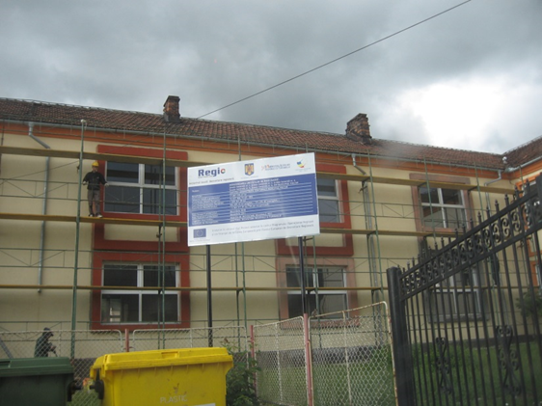
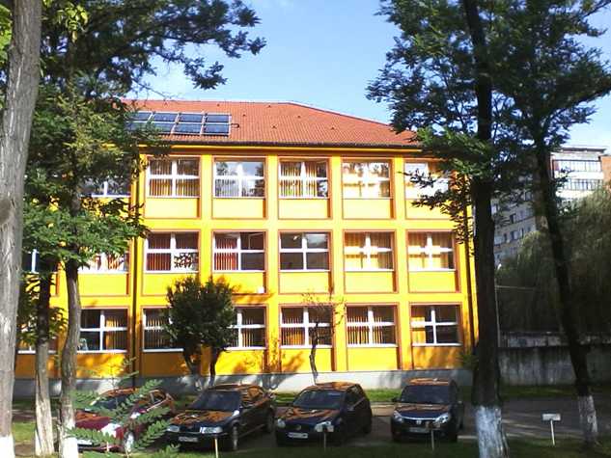
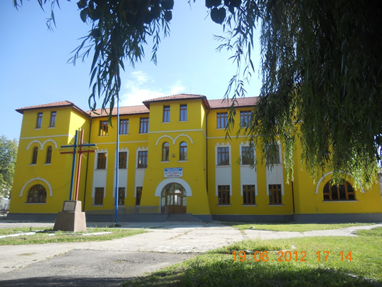
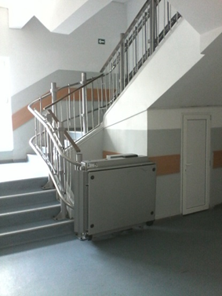
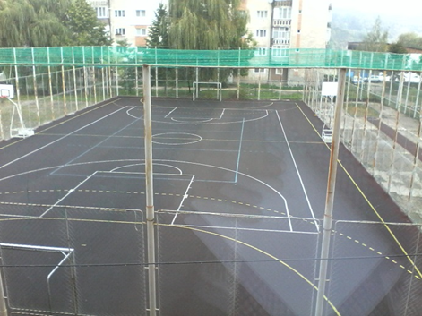
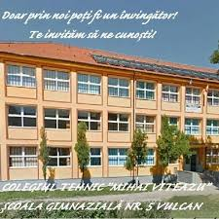
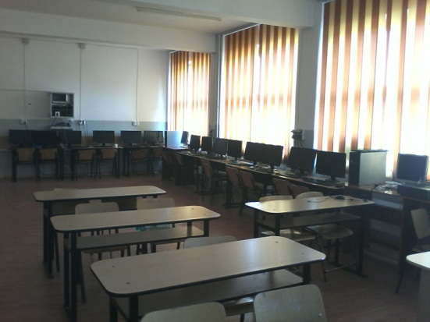
2. MODERNIZATION OF EDUCATIONAL UNITS from Vulcan:
SCHOOL NO. 1 SCHOOL NO. 3 SCHOOL NO. 4 SCHOOL NO. 5 SCHOOL NO. 6 -
4 million euro - implemented 2010-2012

Slide 8
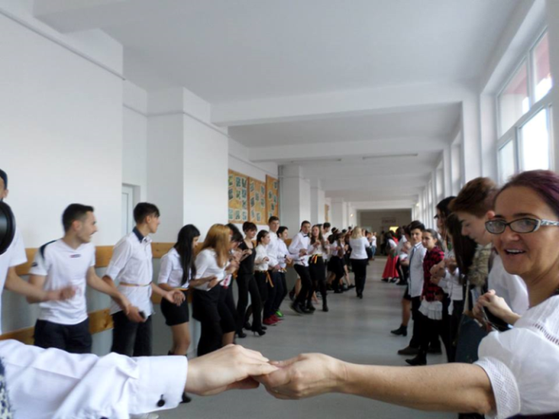
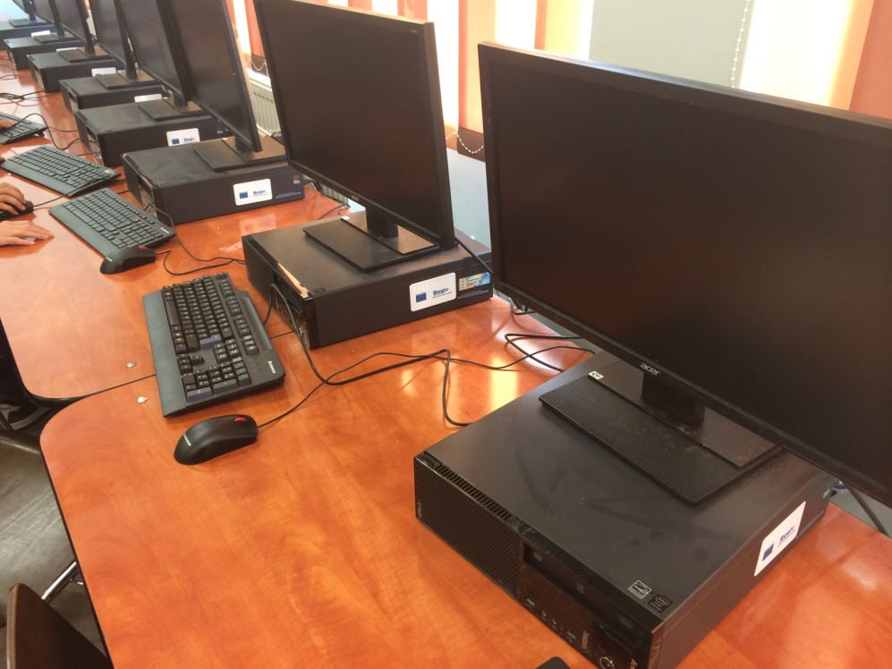
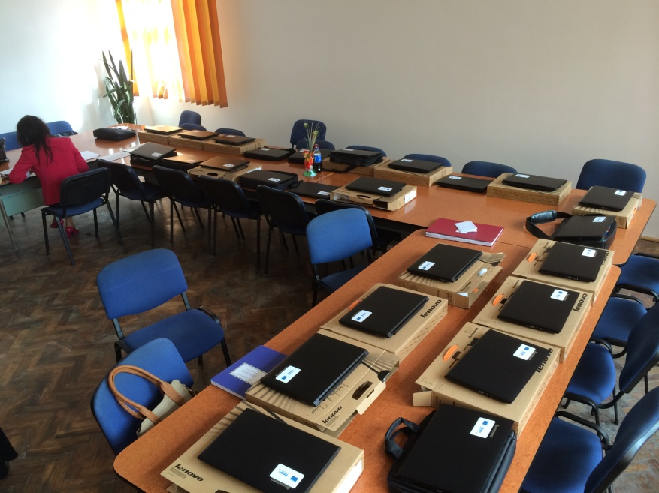
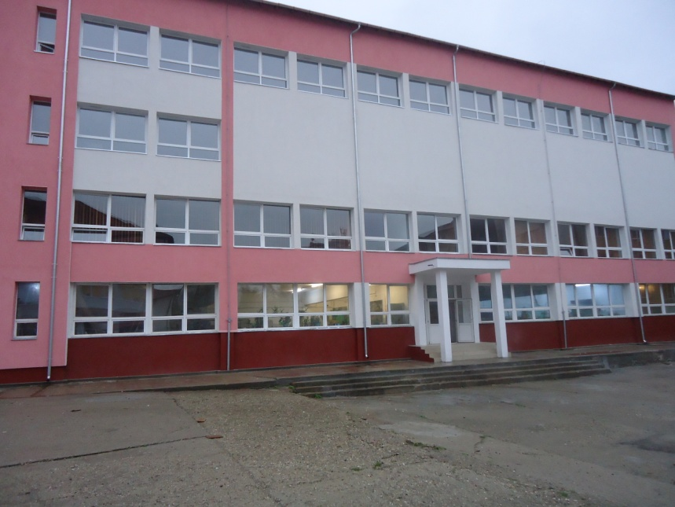
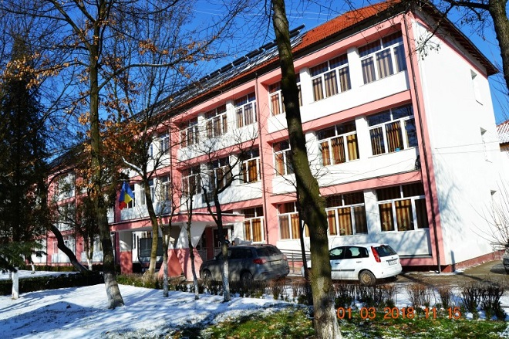
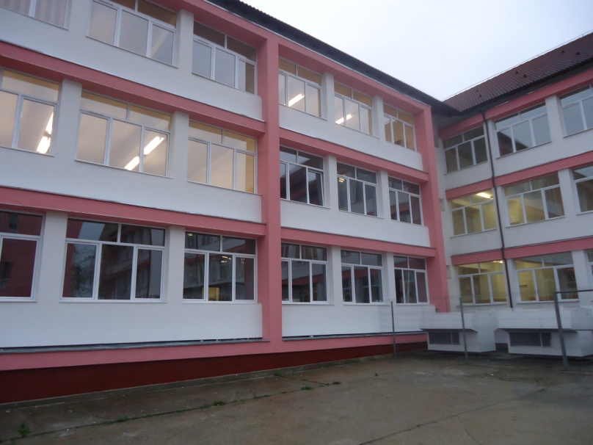
3. MODERNIZATION OF THE TECHNICAL COLLEGE
MIHAI VITEAZU FROM VULCAN MUNICIPALITY –
1,5 million euro – implemented 2013-2015

Slide 9
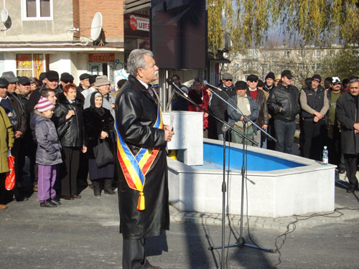
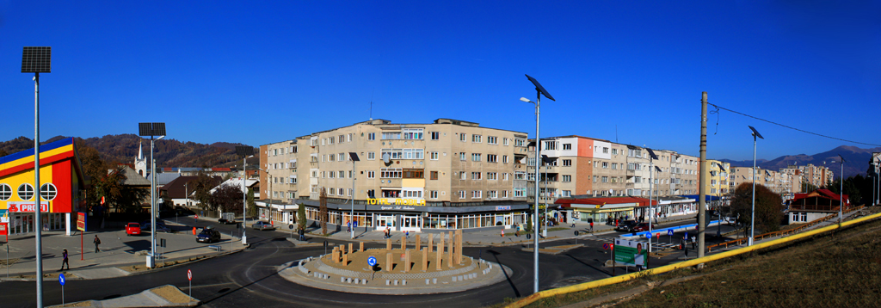
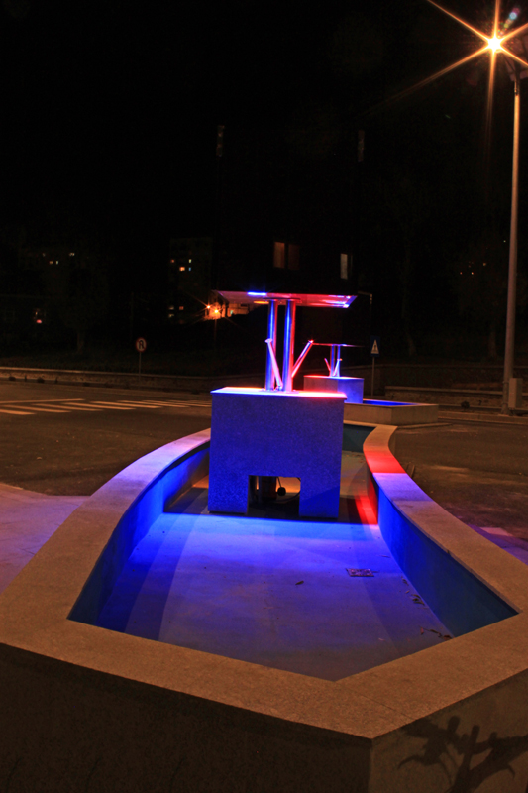
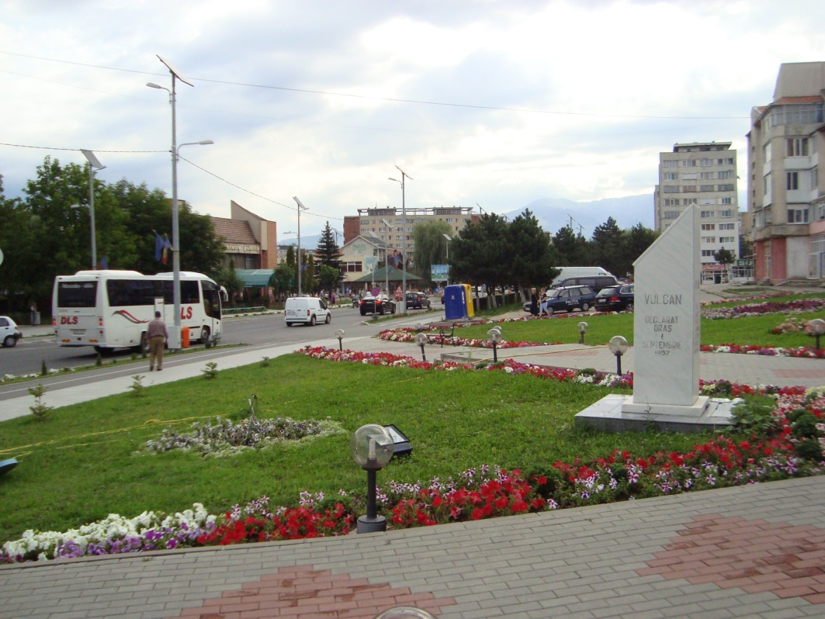
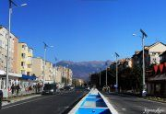
4. MODERNIZATION OF CENTRAL ROAD SYSTEM- MIHAI VITEAZU -FROM VULCAN MUNICIPALITY – 7 million euro implemented 2009-2011

Slide 10
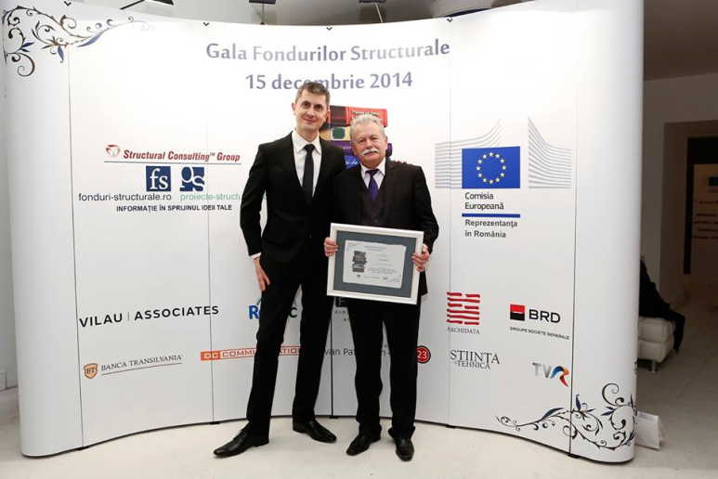
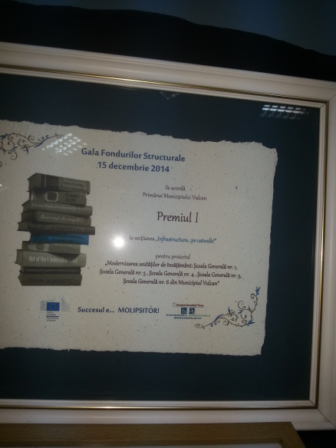
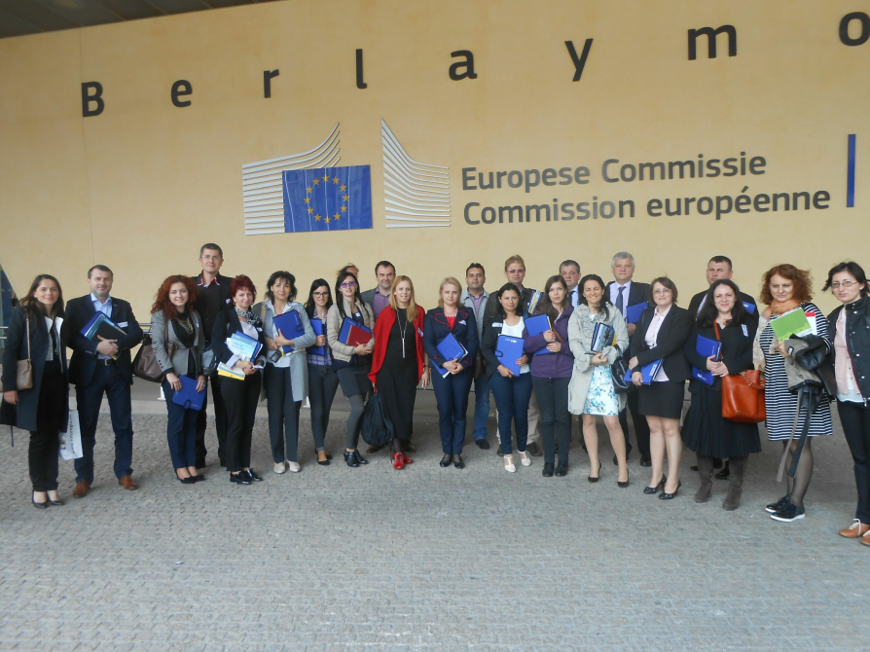
For the modernization of all educational units in the Town, Vulcan got the first prize at the Structural Funds Gala in Brussels – 2015
Two members of the project team visited the European Commission and for a week had direct meetings with European commissioners from all European funding programs. It was a unique experience in life.

Slide 11
The community from Vulcan was found in several projects dedicated to civil society. The local public administration was partner with other communities in the European Union (Italy, England, Finland, Greece, Bulgaria, Slovakia, Hungary….. )2009-2015
The role and involvement of local authorities in employment rate increase – INTERREG IVC– SolidarCity Project
City for citizens, citizens for city
Youth Against Crises

Slide 12
Projects under implementation on European funds, on the Regional Operational Program, during 2018-2023 (infrastructural projects)
Modernization of the ambulatory from Vulcan – 2,5 million euro
Thermal rehabilitation of residential buildings from Vulcan – 1,5 million euro
Ecological transport – Green Line – Jiu Valley – 2 important infrastructural projects - 20 million euro
Kindergarten construction – 0.5 million euro
5. Implementation of the strategy for marginalized urban areas from Vulcan – 4.5 million euro (rehabilitations of roads, public buildings, rehabilitations of urban public spaces and also investments in human capital for the people with social problems from these marginalized areas)

Slide 13
Considering the theme of our project, Romania is part of the European trend of increasing Eurosceptics.
From enthusiastic Euros, Romanians have become Eurosceptics.
Romania joined the European Union - 1st January 2007
Romania is experiencing the highest growth of Eurosceptics after Germany (2017).
In the Internet are a lot of information, but the next one better underline the situation from our country.
.

Slide 14
The European Union has been fighting with disinformation since 2015 (following the decision of the European Council in March 2015).
Increasingly victims of extensive fake news and misinformation campaigns the States from EU truly understand the extent of this phenomenon only after the UK's exit vote from the EU and the latest presidential election in the United States.
Since January 2019 till June 2019, in European Union, 1000 cases of misinformation have been detected, compared to 434 in the same period of last year. (It is important to remember that in May 2019 the European Parliamentary elections took place and specialists noticed that the phenomenon increased).
The exposure of citizens to large scale disinformation, including misleading or outright false information, is a major challenge for Europe.

Slide 15
Disinformation erodes trust in institutions and in digital and traditional media and harms our democracies by hampering the ability of citizens to take informed decisions. It can polarize discussions, create or deepen tensions in society and undermine electoral systems and have a wider impact on European security. It impairs freedom of opinion and expression, a fundamental right in the Charter of Fundamental Rights of the European Union.

Slide 16
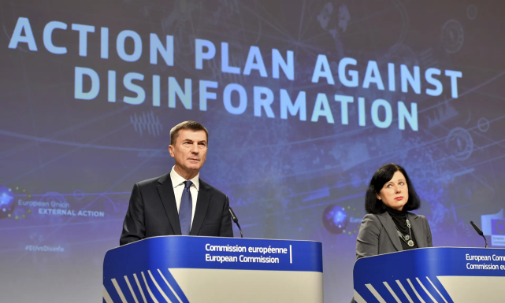
The EU has started a “war against disinformation”. “There is strong evidence pointing to Russia as the primary source of disinformation in Europe,” said Andrus Ansip, vice-president of the European commission.
The European commission said “it would set up a rapid alert system to help EU member states recognize disinformation campaigns and increase the budget set aside for the detection of disinformation from £1.69m to £4.4m (€5m). It will also press technology companies to play their part in cracking down on fake news.”
British security commissioner, Julian King said the EU would not stand for “an internet that is the wild west, where anything goes”….“No excuses, no more foot-dragging, because the risks are real….”
Facebook has admitted there are between 60m and 90m fake Facebook accounts, between 3-4% of users on the platform, King said – “and some of those accounts are the most active”. As an additional information: Facebook is the largest social network in the world, with over 2 billion active users. In addition, the users spend a lot of time on the social network: on average 20 minutes are spent in each session, and users are about 8 times a day on the network.

Slide 17
Longer term, the EU needed to invest in media diversity and educate the public to be aware of the news they digest, King said, but that in the short term Brussels needed to see an “improvement in how we detect and call out disinformation”.
Andrus Ansip, vice-president of the European commission - 2018 (he was prime minister of Estonia) said he did not believe the increased budget of €5m was large enough to deal with the extent of disinformation, saying that one St Petersburg troll factory, known as the Internet Research Agency, has 1.000 full time workers.
Ansip said the Russian disinformation campaigns started “during the KGB time” and that sources said about 85% of the KGB’s budget was spent “not to get some secrets from somewhere but to spread lies”.
“We will not create some kind of propaganda machine in the European Union,” said Ansip. “We would like to detect the disinformation and then we have to understand where those threats are coming from, who is behind the disinformation and then debunking, using facts to expose lies.”

Slide 18
Given the dimensions reached at European Union level, the subjects of our project, we thank the Leader Project for submitting the Financial Request on the Europe for Citizens platform. Also, for the intuition that it will be a winning project and an area of interest to European financiers.
These topics are not very well known at the level of local communities (small communities), but until the information reaches each European citizen, until we do not give importance to these topics and we will not inform ourselves, avoiding misinformation, having “healthy sources of information”, we can say that we are in a war, in a fight with ourselves, with others (the mental fight in which we are involved and those who are interested in manipulating our brains).

Slide 19
Conclusions Misinformation book published online
The information, properly exploited and managed, can make a decisive contribution to winning a war;
Conflicts of the future will revolve around informational manipulation and modification of human behavior, even in the last instance, without firing a weapon.

Slide 20
“There are three things you can't return: time, word and possibility. Therefore: do not waste time, choose the words, do not waste the opportunity.” – Confucius.
So, we didn’t waste the opportunity, we came here (2000 km ☺) to be together - 2 European States, with a long and common history
We had closed cooperation and collaboration. The past has taught us that if we treat each other with respect, sympathy and empathy, we embrace the common European themes of interest we will build today, a safer future for us, as citizens and Christians of Europe.

Slide 21

ITALY- ROMANIA- A LONG LASTING PARTNERSHIP
At the end we say again that images and facts speak more than words!

